Slide 1

Multi-genre Speaker recognition
Mid-Semester Project Evaluation of Stage I SOHAM NANDI (Roll No. 2404102003) Under the Guidance of
Dr. Vivek Kanhangad Department of Electrical Engineering
Indian Institute of Technology Indore

Slide 2
Content:
1.Introduction 1.1 what is multi genre Speaker recognition 2. Project Flowchart 3.Project Updates( comparison between dataset, Mfcc, spectrogram, database,Model Training) 4.Future Updates

Slide 3
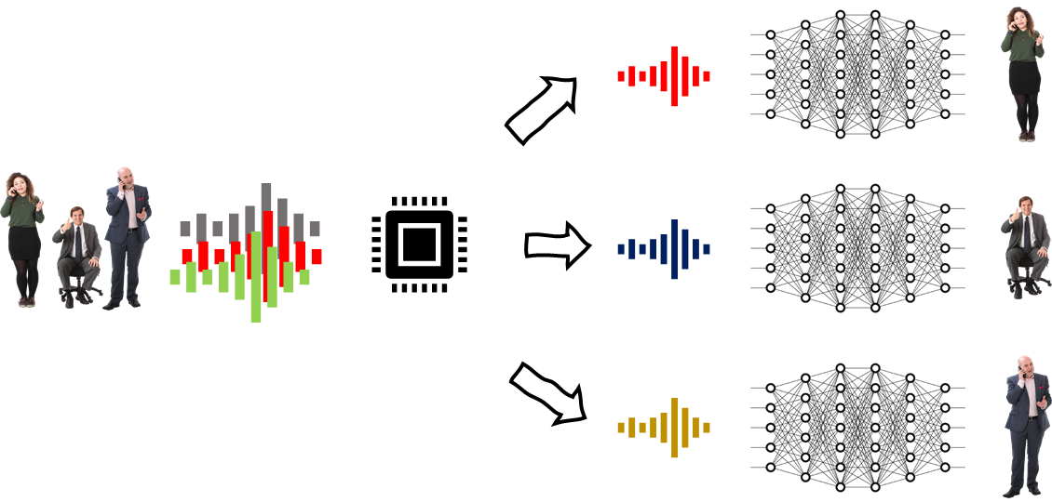
Introduction:
Multi-Genre Speaker Recognition refers to a system that can identify speakers across different audio genres, such as music, podcasts, or conversations.The primary objective of speaker recognition is to accurately identify or verify a person’s identity based on their unique vocal characteristics. It aims to achieve high accuracy across diverse audio environments and conditions, ensuring security, personalization, and user convenience in applications like authentication, forensics, and voice-controlled systems
Random environment
Classified genres audio signal

Slide 4
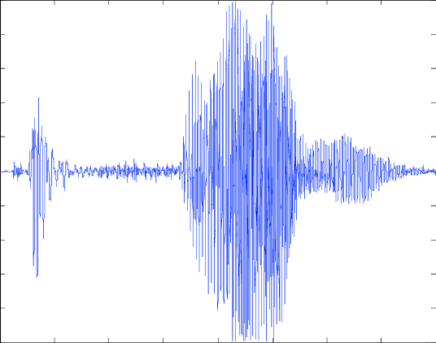
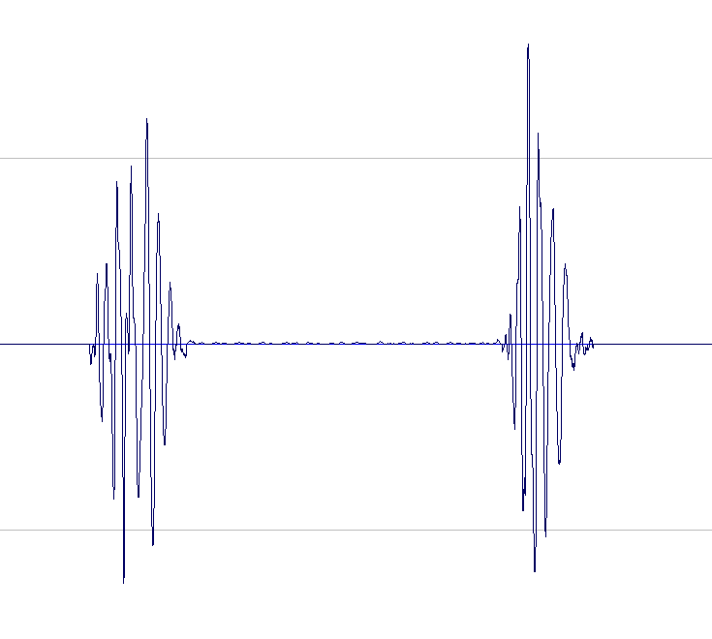
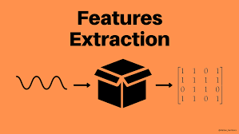
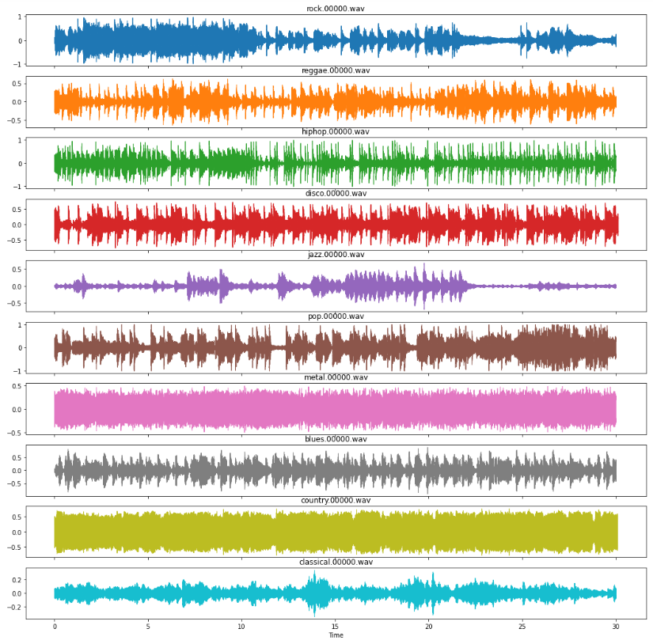
Project Flowchart:
Pre processing
Raw Data
Audio feature Extraction
Model Training And Test verification
MODEL TRAINING And Testing

Slide 5
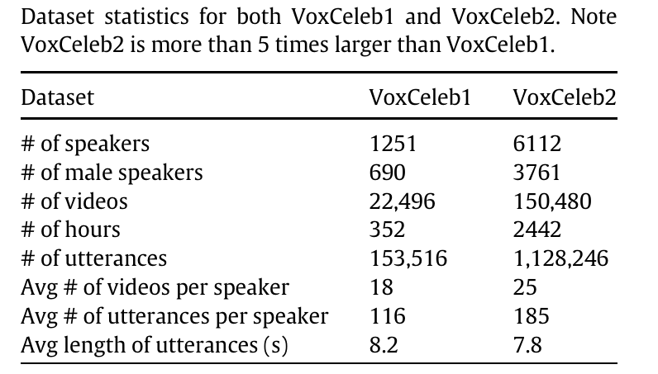
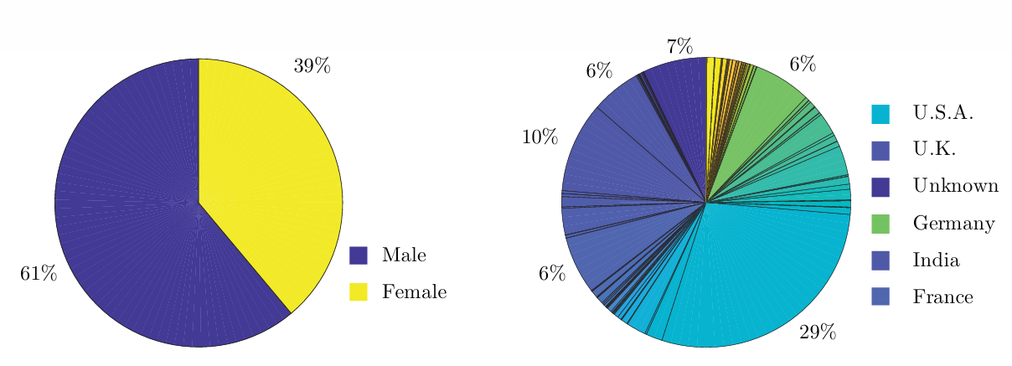
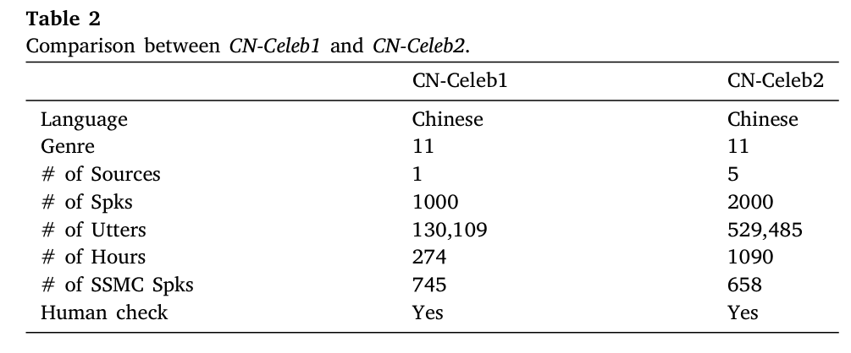
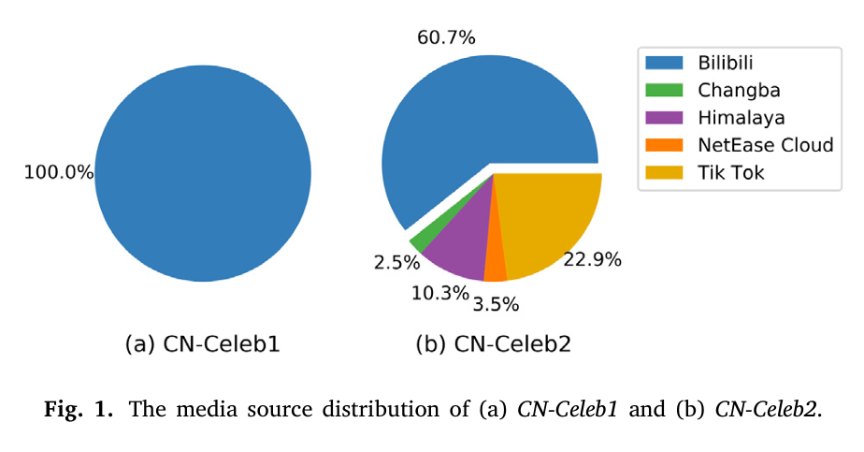
DATASET:
VOX-Celeb Dataset: DataSet based on English Speaker
Cn-Celeb Dataset: Dataset based on mandarin speaker

Slide 6
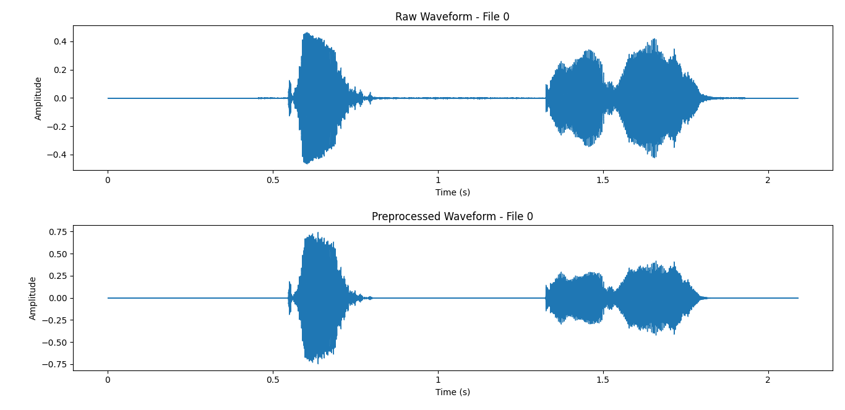
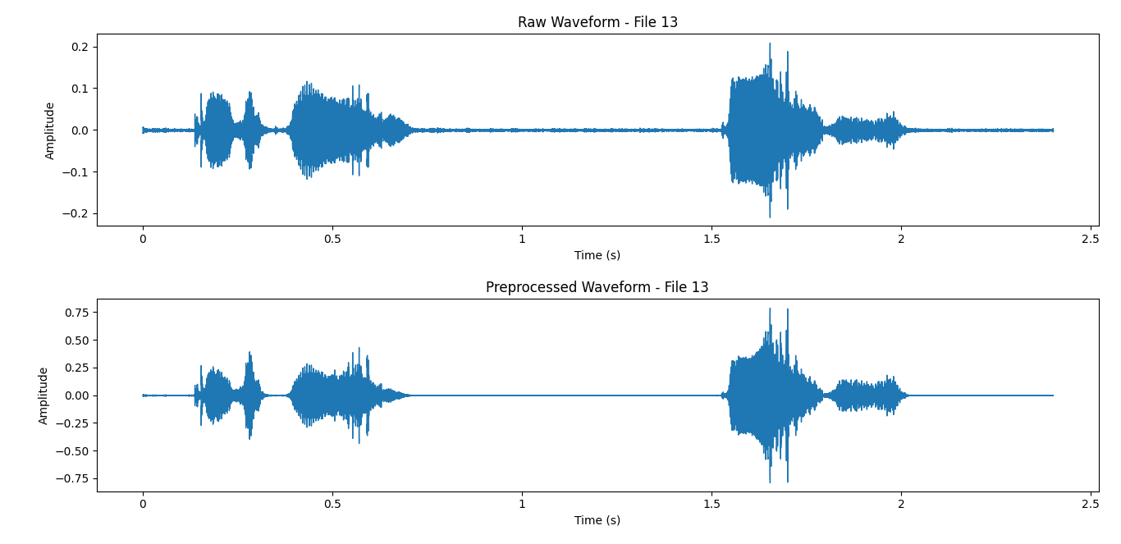
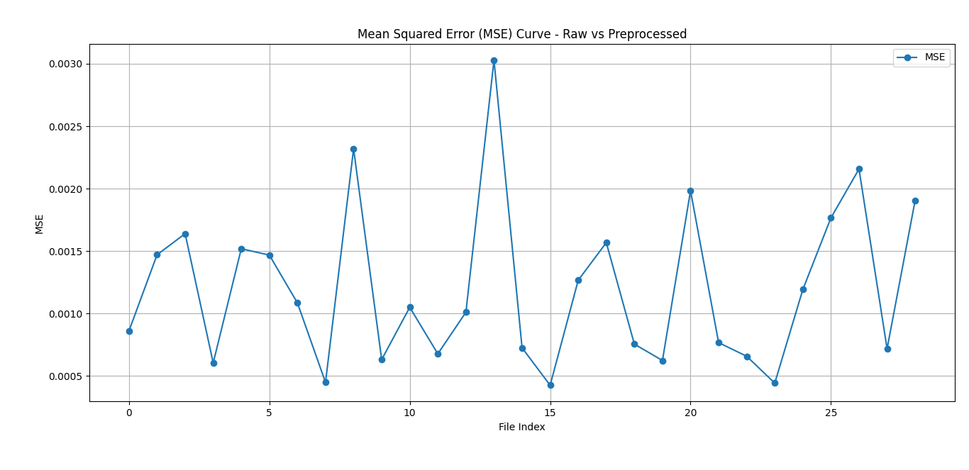
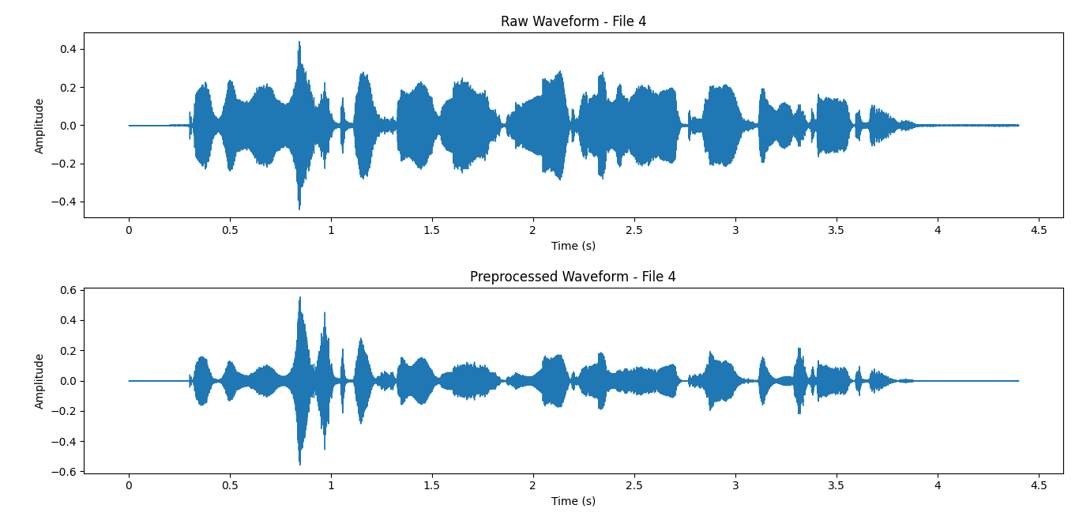
Project Updates:
A. DATA PREPROCESSING:

Slide 7
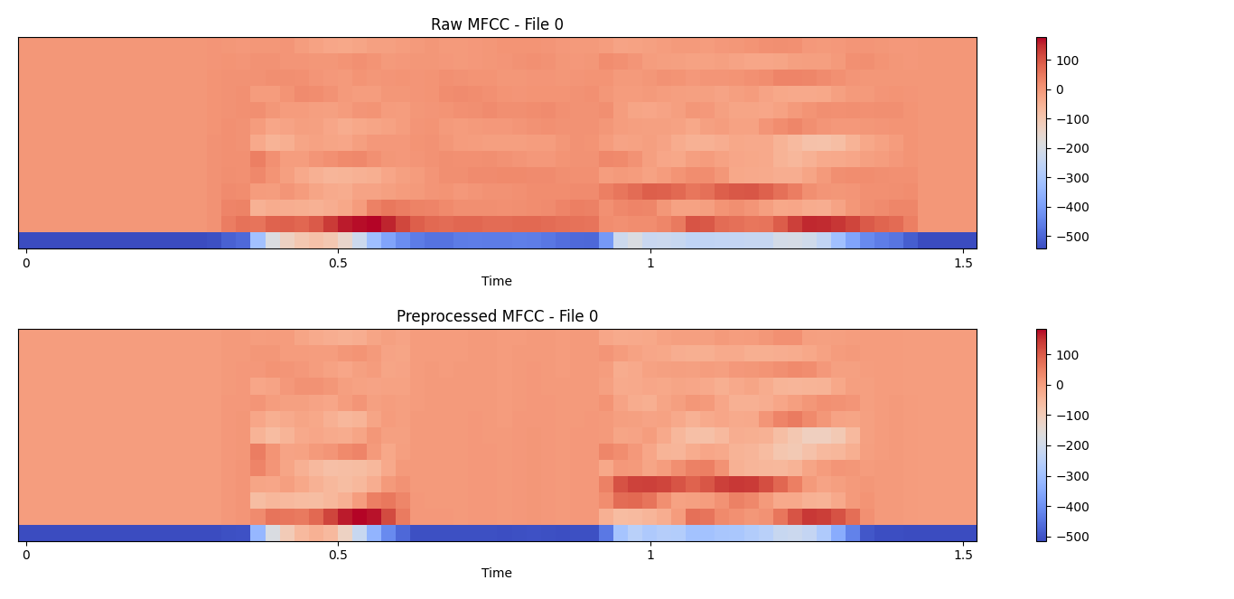
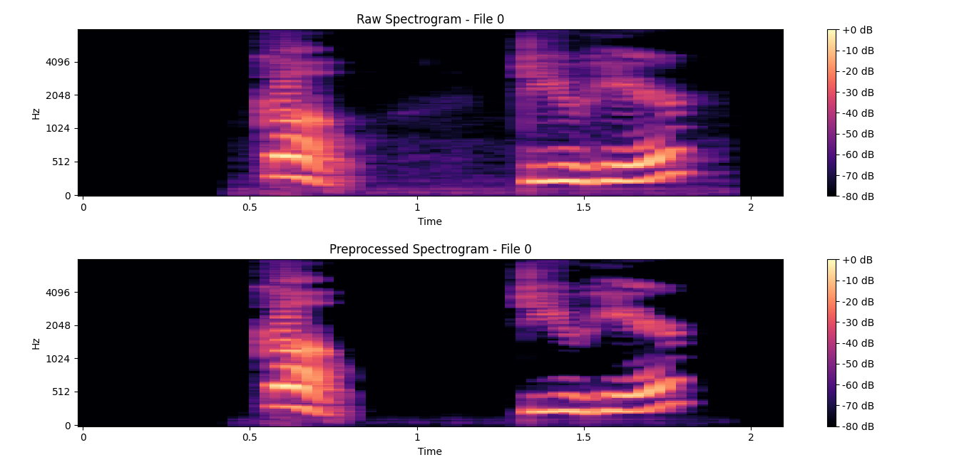
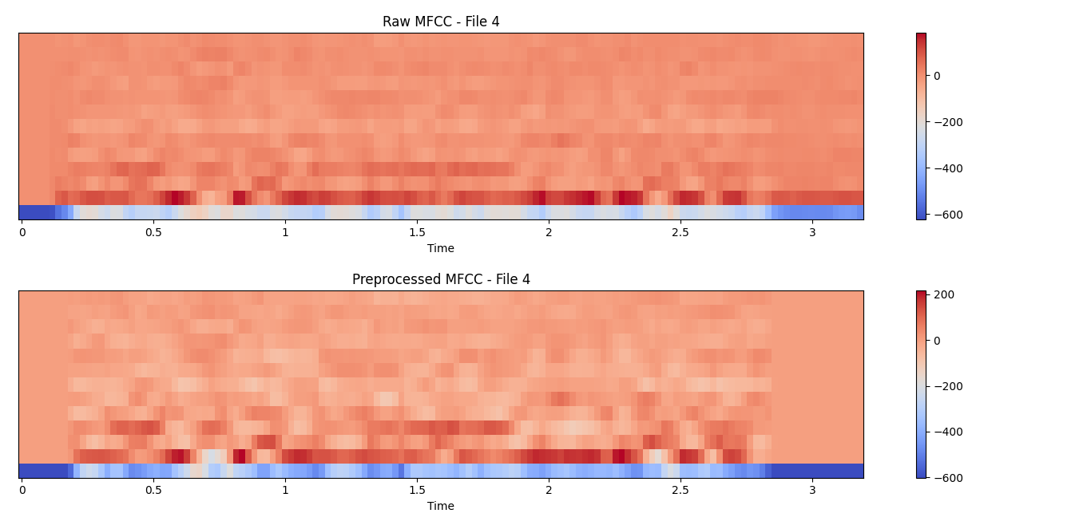
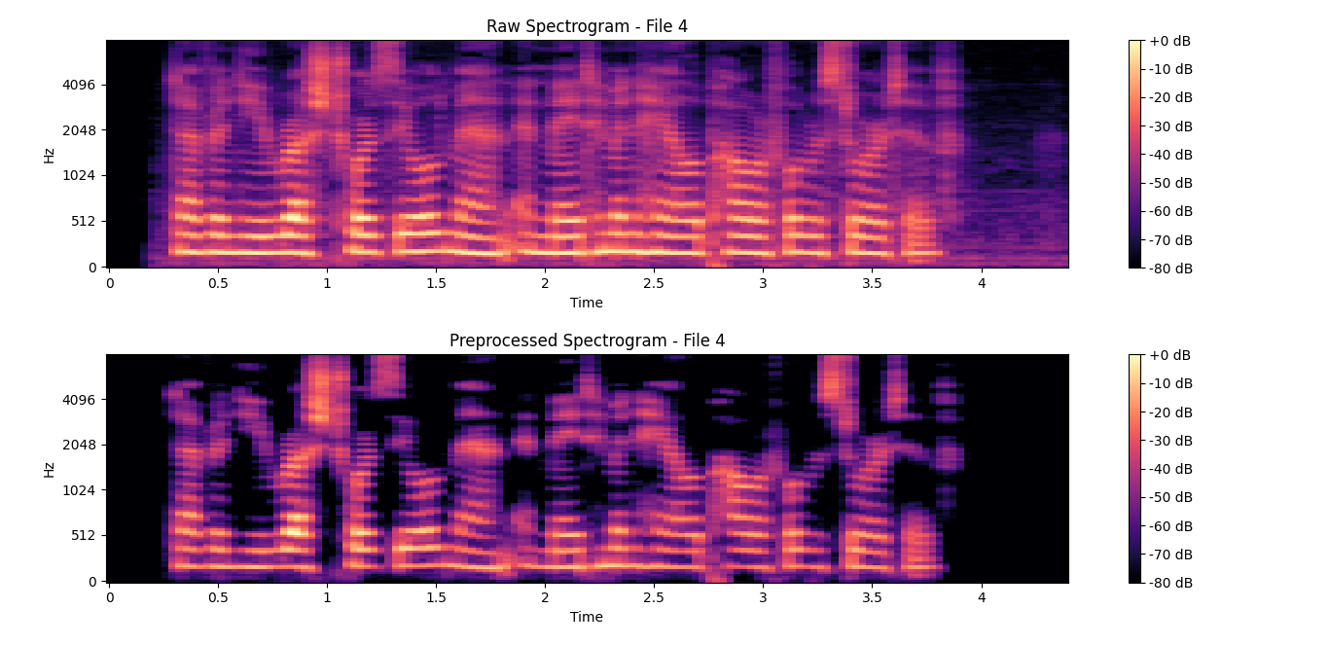
Audio Features Extraction:
MFCC Extraction
Spectrogram

Slide 8
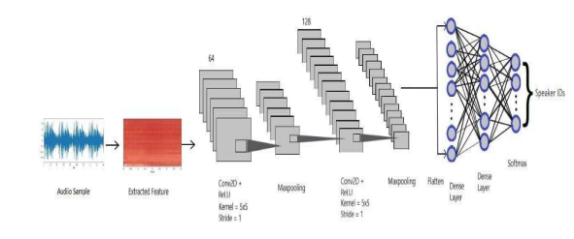
CNN Architecture:

Slide 9
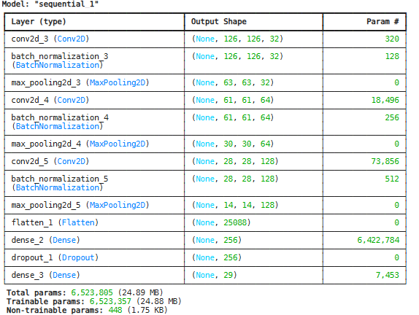

Model training Result:

Slide 10
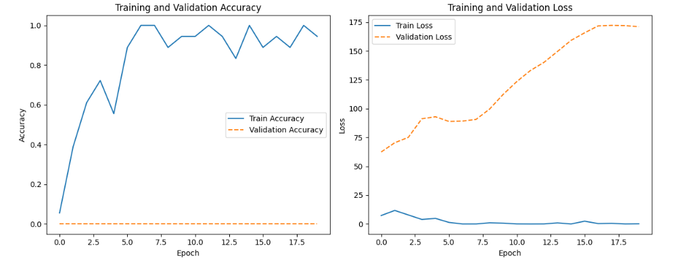
Model training Result:

Slide 11
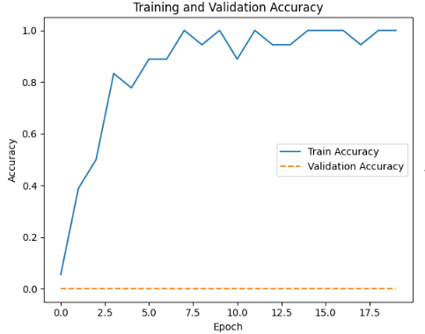
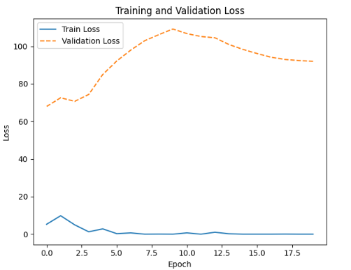
Model training Result:

Slide 12
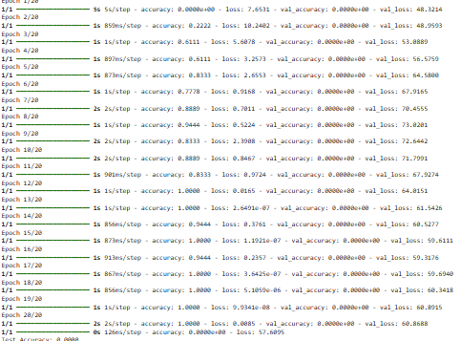
Model training Result:

Slide 13
Reference:
S. Hershey et al., "CNN architectures for large-scale audio classification," 2017 IEEE International Conference on Acoustics, Speech and Signal Processing (ICASSP), New Orleans, LA, USA, 2017, pp. 131-135
N. N. Prachi, F. M. Nahiyan, M. Habibullah and R. Khan, "Deep Learning Based Speaker Recognition System with CNN and LSTM Techniques," 2022 Interdisciplinary Research in Technology and Management (IRTM), Kolkata, India, 2022
A. Mansour, F. Chenchah and Z. Lachiri, "Emotional speaker recognition based on i-vector space model," 2016 4th International Conference on Control Engineering & Information Technology (CEIT), Hammamet, Tunisia, 2016

Slide 14
THANK YOU

